Slide 1


Titolo presentazione sottotitolo
YASC
Milano, XX mese 20XX

Slide 2
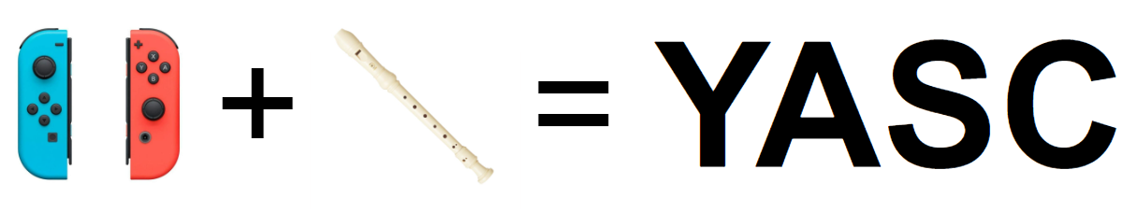
Introduction
YASC redesign the recorder playability with real-time responsive feedback to ensure an immersive musical performance using Joy-Con controllers, a web interface and SuperCollider synthesis capabilities.

Slide 3
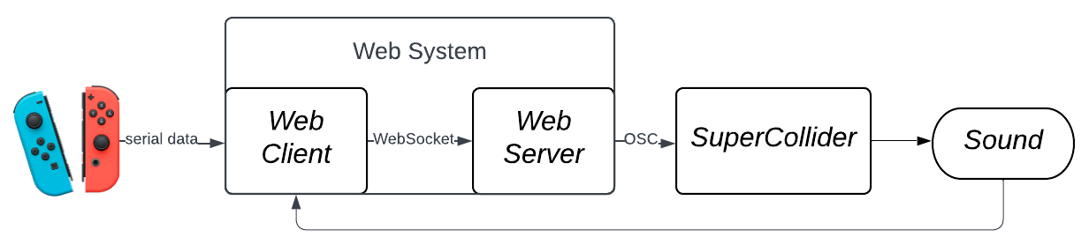
Structure overview
Overall structure:
User interaction accomplished with Joy-Con controllers.
Web system acts as main interface.
SuperCollider serves as sound synthesis engine, generating/editing sounds according to the web system commands sent via OSC protocol.
Sound captured by the web system to provide visual feedback.

Slide 4
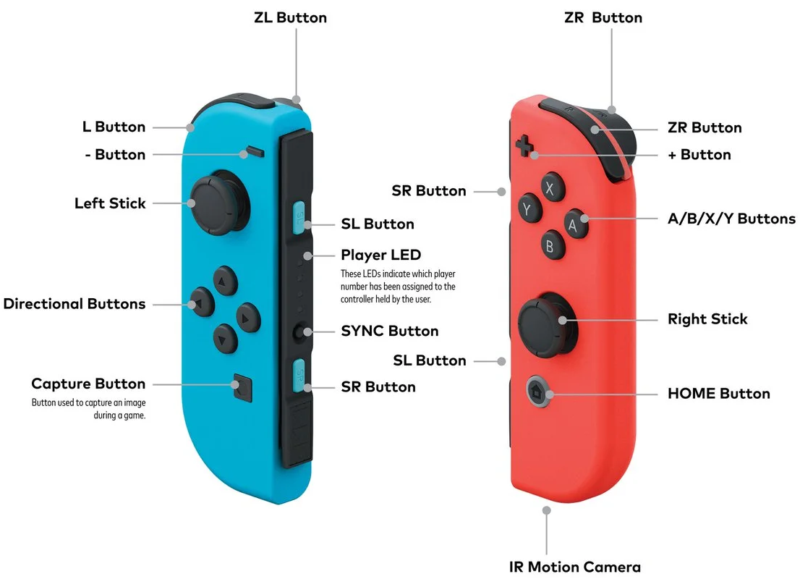
Joy-Con controller
The left controller handles parameters in SuperCollider.
The right one is dedicated for playing notes.
Buttons, analog sticks, gyroscope and motion sensors are employed to control sound.

Slide 5
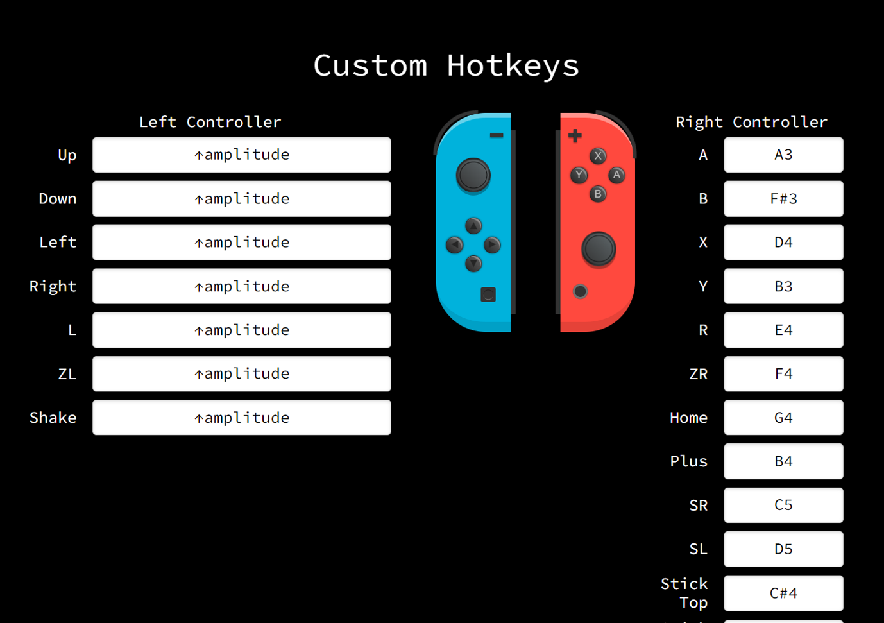
Web system – GUI
Hotkey page, for customizing buttons and controls.
Using localstorage to save

Slide 6
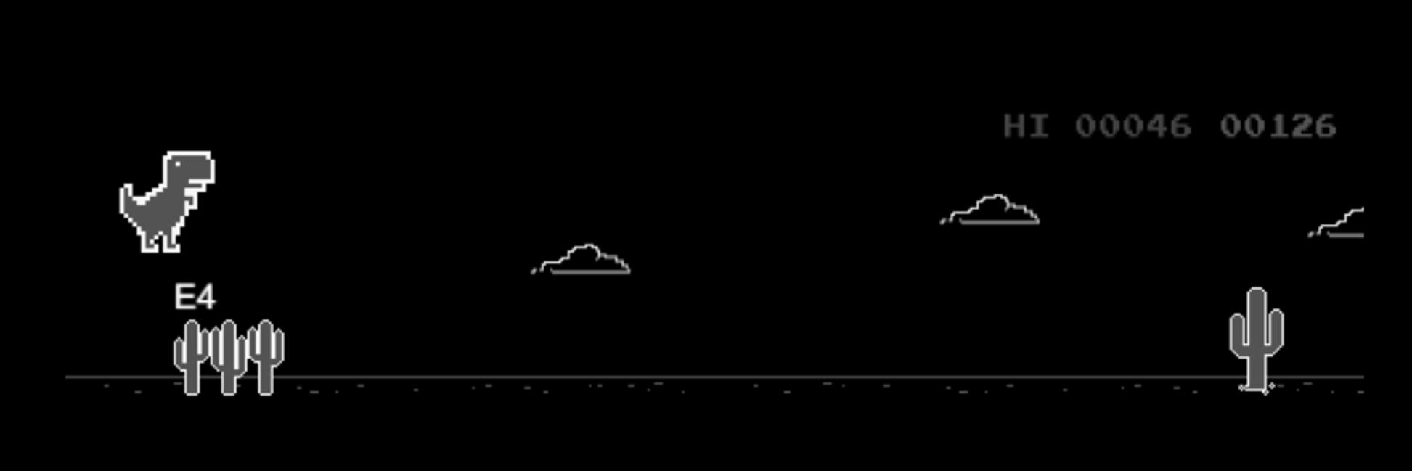
Web system – GUI
Using canvas

Slide 7
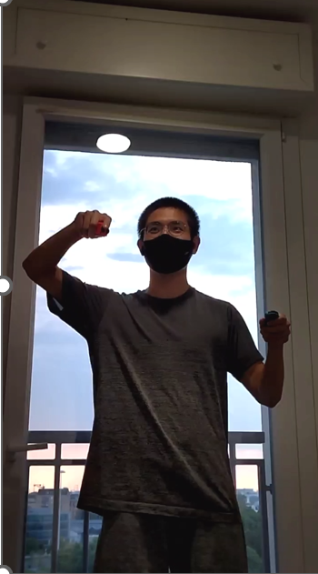
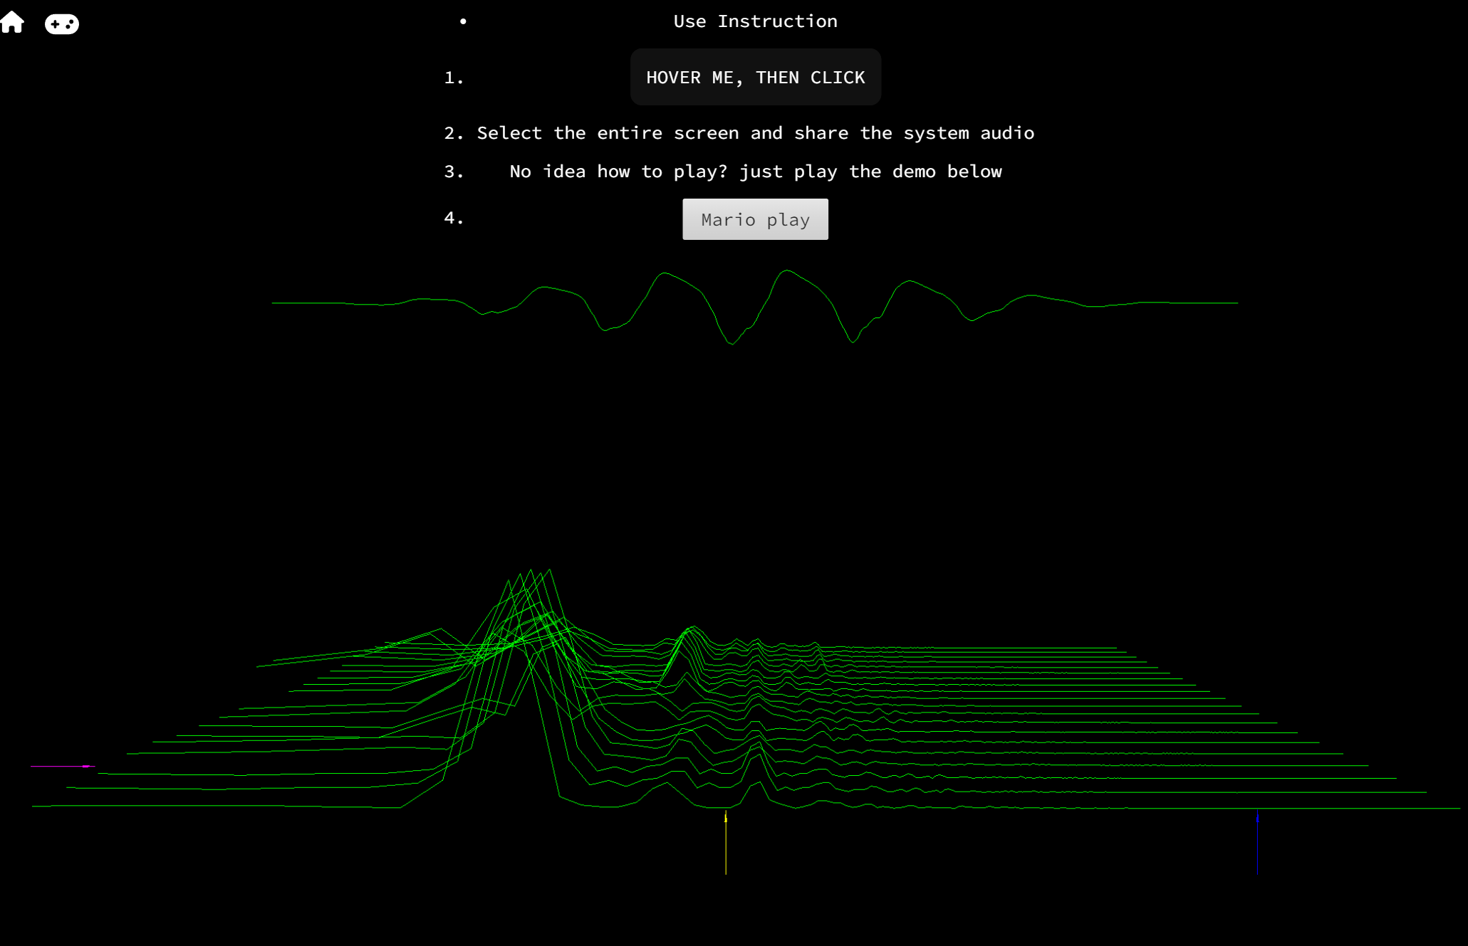
Web system – GUI
Using Meyda and Three.js

Slide 8
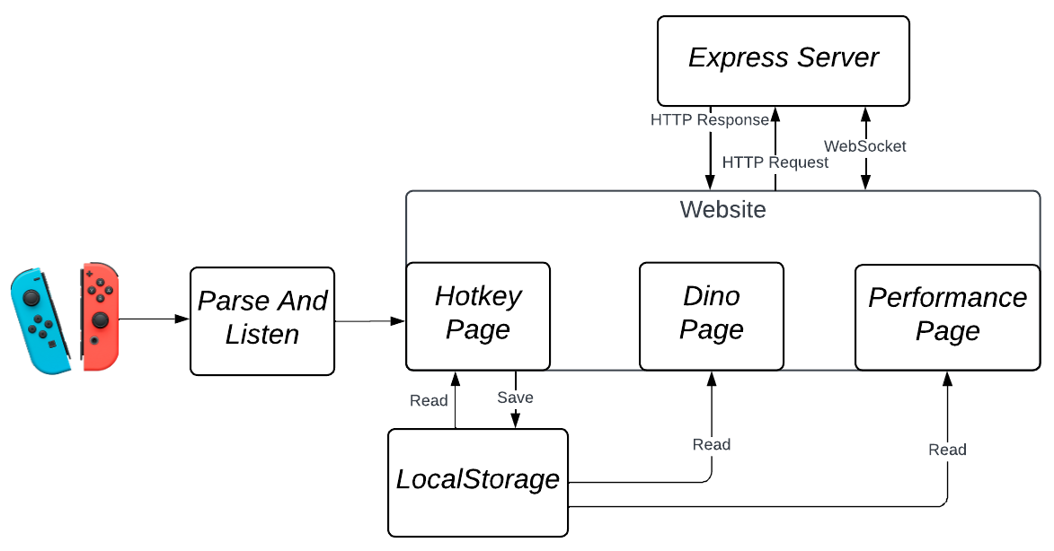
Web system – Implementation
There are three main components which run the web system:
Parse and Listen: parses the input, maintains the connection with the controllers and manage the registered events.
LocalStorage: offers save and read services for hotkey configuration.
Express Server: serves static files and handles OSC messages transmission using WebSocket.

Slide 9
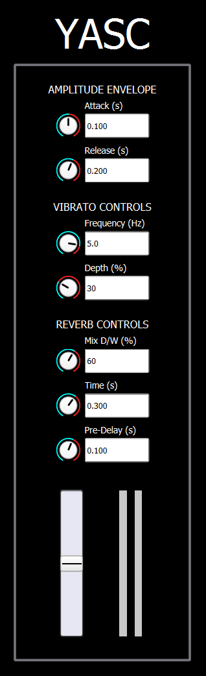
Sound synthesis – GUI
The recorder sound and a simple reverb effect are produced in SuperCollider. The user can see the changes made with controllers of some parameters:
Amplitude envelope attack and release time.
Vibrato frequency and depth.
Reverb D/W mix, time and pre-delay.

Slide 10
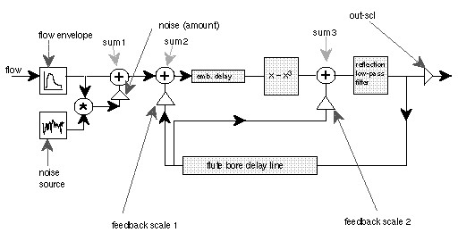
Sound synthesis – Implementation
SynthDef «flute» emulates the sound of a recorder through digital waveguide synthesis. The model employed is based on Perry Cook’s one with the addition of a LFO to reproduce vibrato.
Initial breath signal is simulated with a noise.
Two delay lines model holes and embouchure effects.
A cubic function models the wave bouncing in the real instrument.
A low-pass filter simulates the faster decay of high frequencies.

Slide 11
Thanks

